Slide 2
ASIA
China
West Asia
Japan
Russia
SE Asia

Slide 3
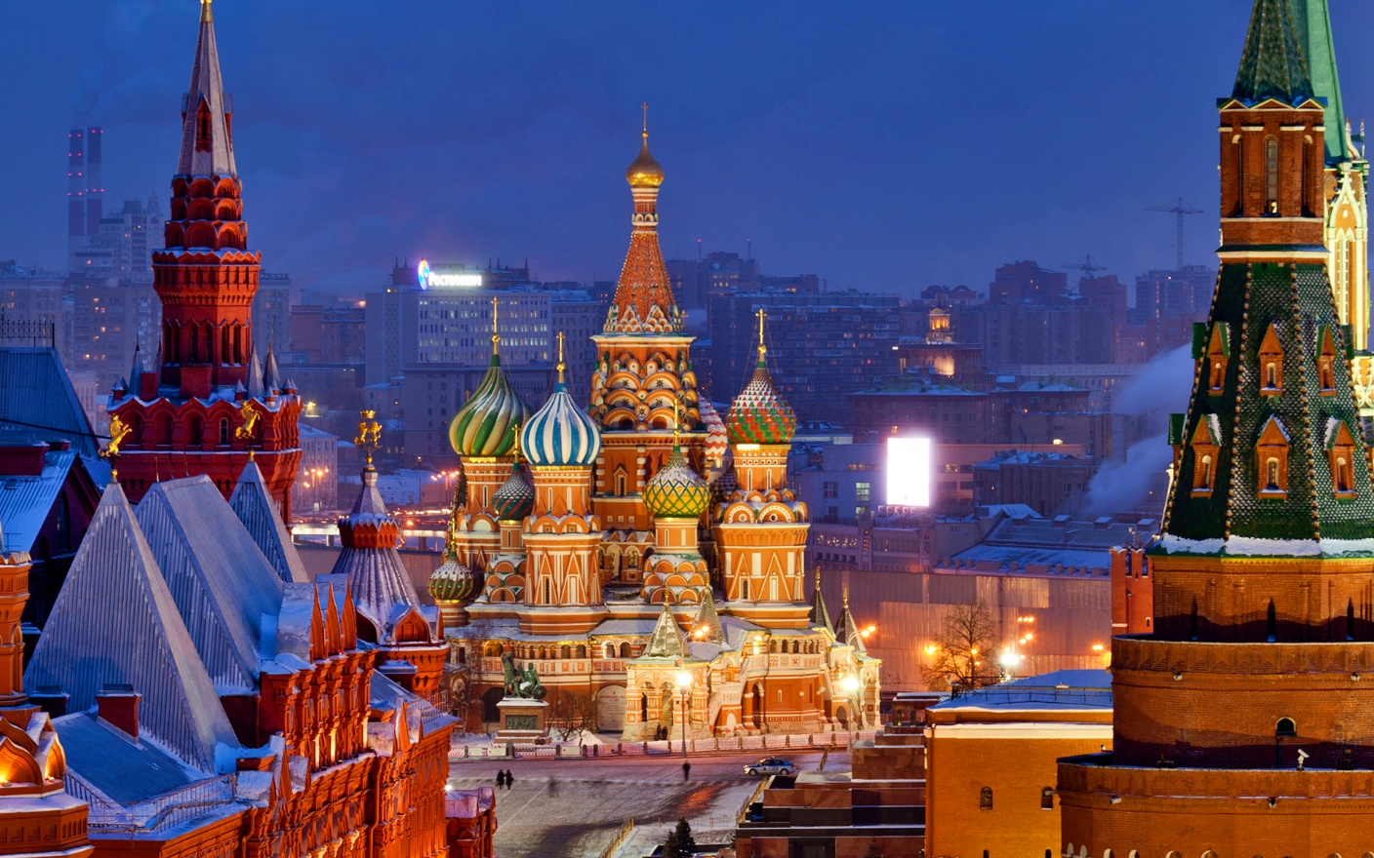
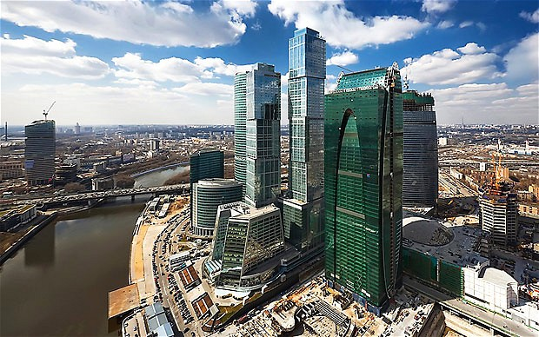
Russia

Slide 4
Russia
Largest country in the world
Russia 5 times bigger than India
Russia – total 8 time zones

Slide 5
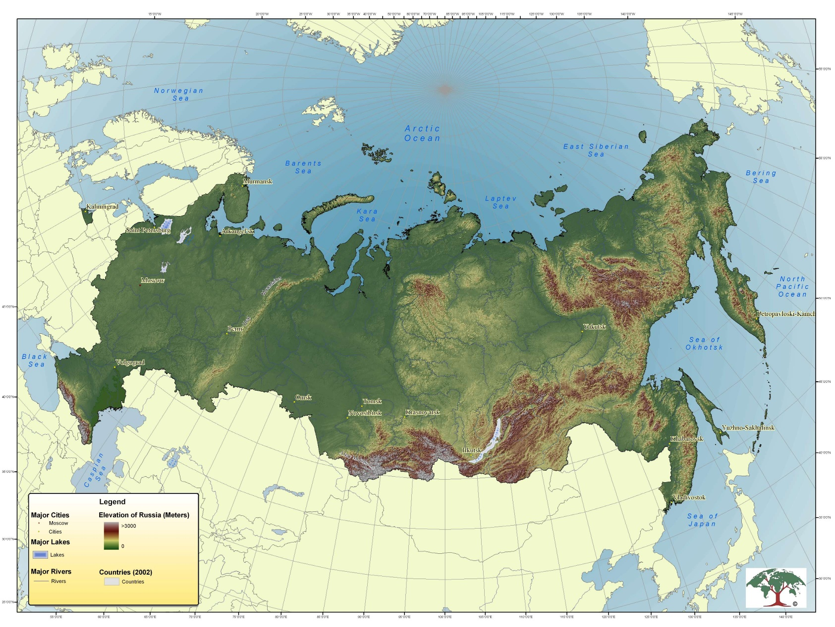
Water-bodies around Russia
Chukchi sea
East Siberiansea
Bering strait
Baltic sea
Barents sea
Leptev sea
Bering sea
white sea
Kara sea
Sea of Okhotsk
Black sea
Caspian sea
sea of Japan

Slide 6
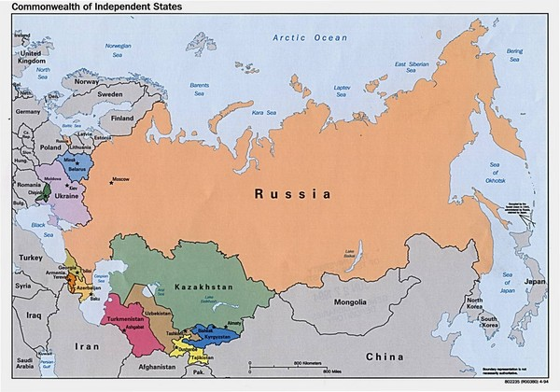
Access to Sea

Slide 7
Important ports of Russia
Murmansk – ice free port – Barents sea
St. Petersburg – Baltic sea
Rostov – Black sea
Vladivostok – Japan sea (less population)
Murmansk
St. Petersburg
Rostov
Vladivostok

Slide 8
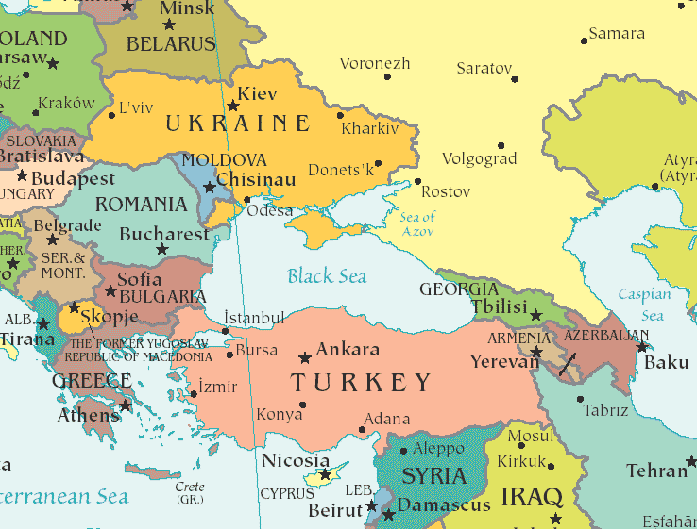
Crimean Peninsula

Slide 9
Physical Geography of Russia
Novaya Zemlya
Kola Peninsula
Koryak range
Lake Ladoga
Lake Onega
Taymyr
Pen
Valdai hills
Yamal Pen
Gyda pen.
Kolyma range
Kamchatka Peninsula
Ural mountains
Central Siberian Plateau
Verkhoyansk range
west Siberian Plain
Sakhalin Island
Lake Baykal

Slide 10
Urals
One of the oldest mountain range in world
Highest peak of Urals – Narodnaya
Extension into Arctic sea as Novaya Zemlya
Not continuous, has many gaps
Kola peninsula - copper
Novaya Zemlya
Ural mountains

Slide 11
Western Siberian Plain
Russia’s most extensive land region
Swamp and marshes
Major Source of Natural gas for Russia
Yamal Peninsula also known for petroleum reserve
Yamal Pen
west Siberian Plain

Slide 12
Central Siberian Plateau
Winter – anti-cyclonic condition
Sparsely populated
South to North -> Steppe, mixed deciduous, Taiga, Tundra, Perma frost
Paper and pulp industry
Untapped Petro-reserve
Central Siberian Plateau

Slide 13
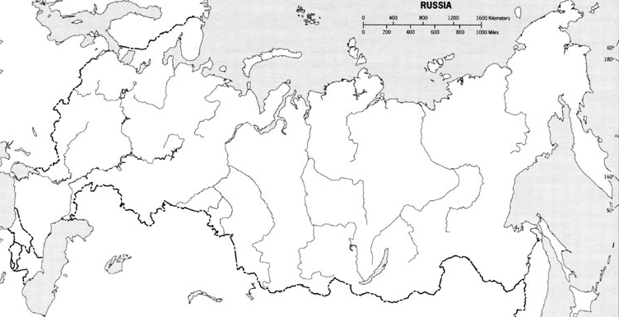
Important rivers of Russia
Pechora basin
Ob
Don
Lena
Yenisei
Volga
Sea of Azov
Irtysh
Lake Baykal
Amur

Slide 14
Rivers and Lake in Russia
Most rivers are navigable but only in summer
Frozen in winter
Freezing at mouth – close to Arctic
Create swampy condition in the middle of the rivers
Lake Baykal – largest fresh water lake of the world (by quantity of water)

Slide 15
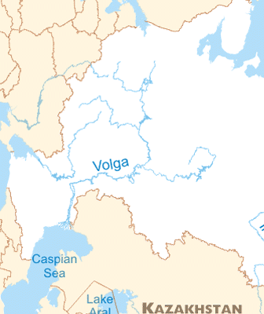
Don river
Drains into Sea of Azov
Rostov city is on Don
Volga- Don canal [connects Black sea with Caspian sea]
Don
Sea of Azov
Rostov

Slide 16
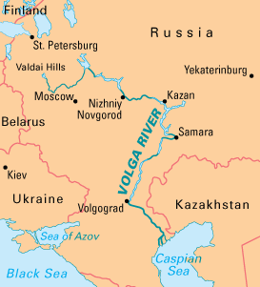
Volga river
Originated in Valdai hills
Most important water way
Cities on river:
Nizhny Novgorod, Kazan, Samara and Volgograd

Slide 17
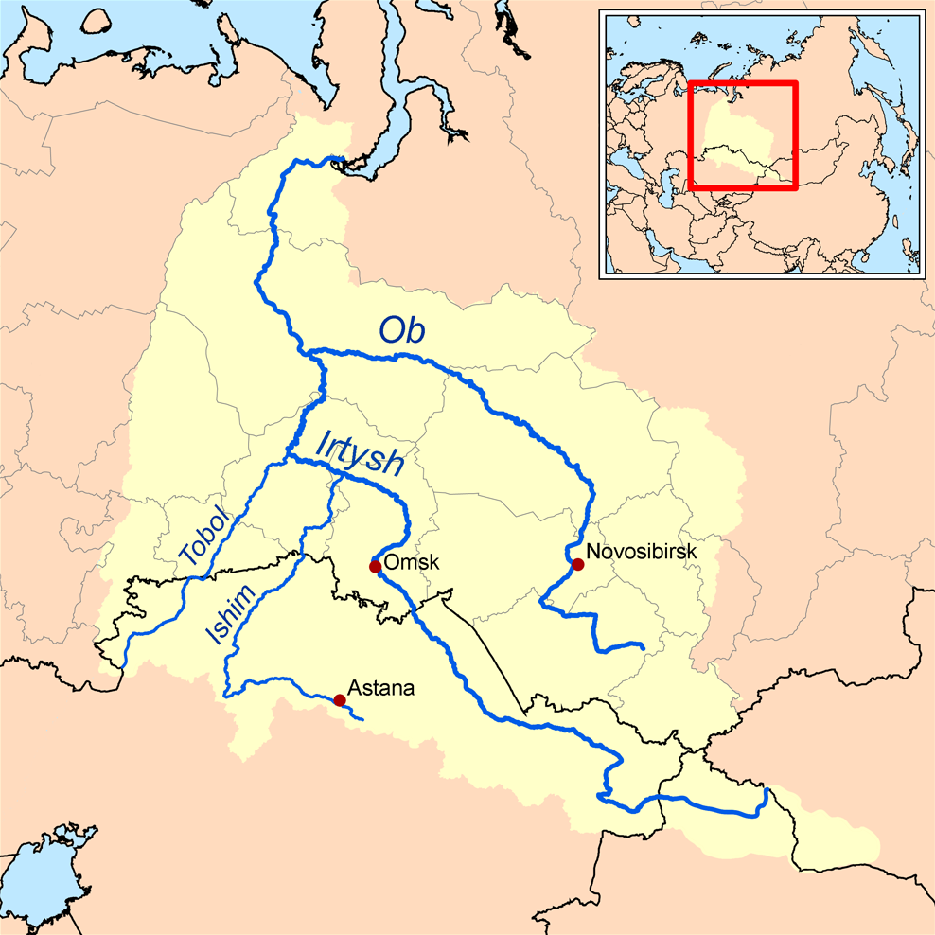
Ob-Irtysh river
Largest river of Russia by volume
Omsk on Irtysh
Novosibirsk on Ob
Ob-Irtysh – Vasugnya swamp (one of the largest swamp)
Irtysh drains into China’s Dsungarian basin

Slide 18
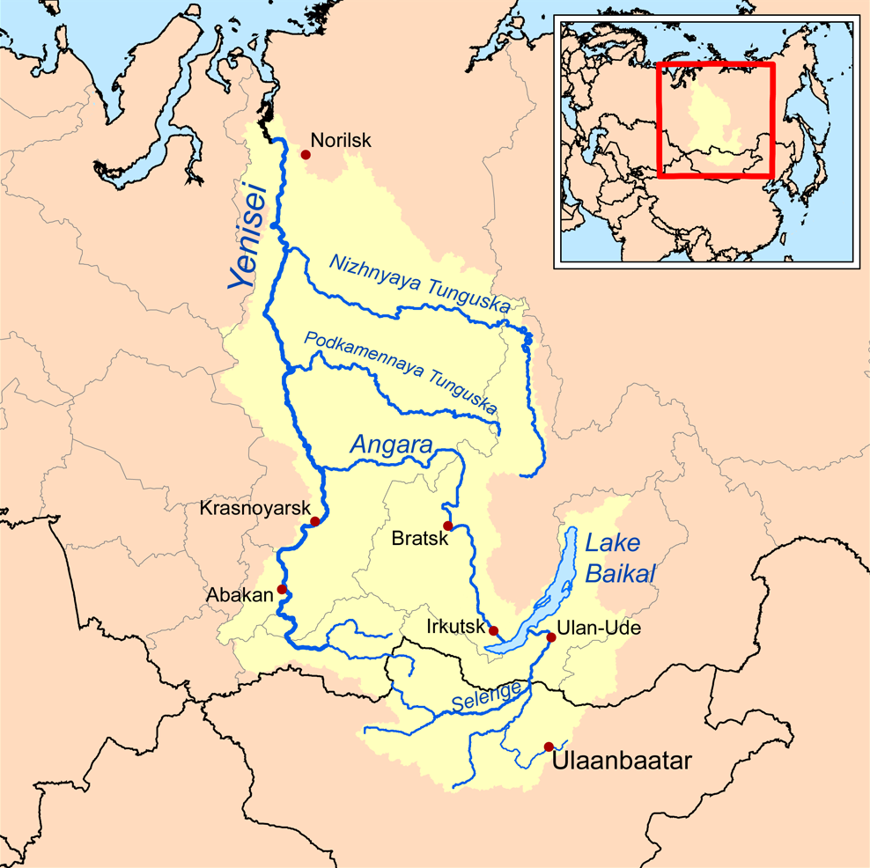
Yenisei river
From Western Sanyan hills and Baykal lake
Cities on river:
Bratsk, Ulan-Ude and Krasnoyarsk on Yenisei

Slide 19
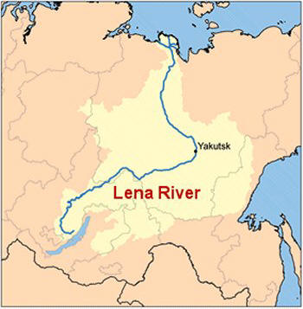
Lena river
From Lake Baykal
City on river:
Yakutsk on Lena
Verkhoyansk

Slide 20
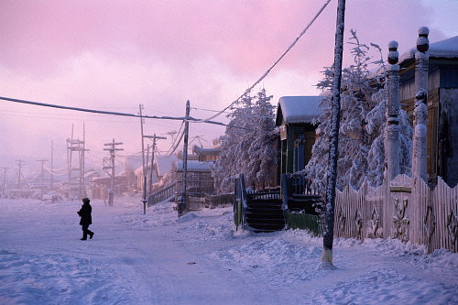
Climate of Russia
Influence of Continentality
Verkhoyansk – one of the coldest inhabited place in the world
Russia - Artic climate most prevalent
Taiga and Tundra climate

Slide 21
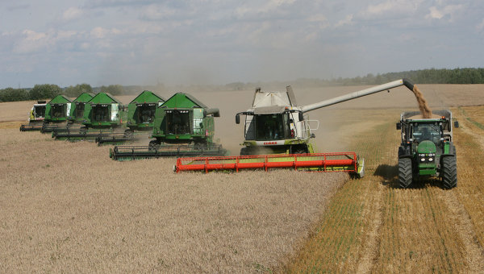
Agriculture in Russia
Limited growing period
40% pastures and meadows
Wheat, Oil-seeds, cotton - important
Oat, mustard, corn, sugar beet, flax
Potato – very important

Slide 22
Russian economy
6th largest economy of the world by PPP
World’s largest reserve of natural gas and largest exporter of crude oil
Today oil, gas and minerals account for 80% of Russia's export earnings and 50% of federal revenue
World’s second largest coal reserve
Russia is world’s second largest arms exporter
Largest diamond producing nation

Slide 23
Urals
Siberia
Coal – Chelyabinsk , slopes of Urals, Pechora field
Gold, platinum, chromite, bauxite
Semi-precious stone
Large deposits of gold, diamond
Manganese, lead, zinc, cobalt, molybdenum
Lena- Tunguska petroleum reserve, Khanty – Mansiysk region (70%)

Slide 24
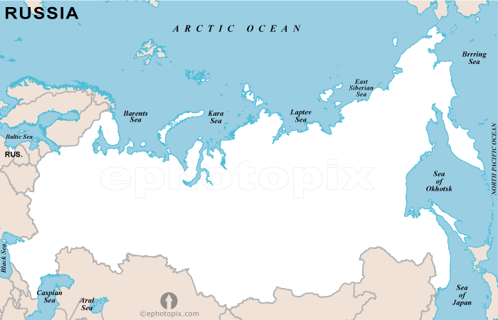
Coal Reserve of Russia
2nd largest coal reserve in the world
Pechora Basin
Novo Kuznetsk
Krasnoyarsk
Magnitogorsk
Chelyabinsk
Kemerovo
Irkutsk
Chernogorsk

Slide 25
Iron ore Reserve of Russia
5th largest Iron production in the world
Belgorod
Kursk
Tomsk
Magnitogorsk
Voronezh
Orsk

Slide 26
Nickel reserve
World’s 40% of nickel –Norilsk mine
Kola Peninsula
Tymr peninsula
Norlisk
Amur region

Slide 27
Petroleum regions
West Siberia
Urals-Volga
Sakhalin Island
East Siberia
Yamal Peninsula
North Caucasus
Pechora Basin and Barents sea

Slide 28
Petroleum reserve
West Siberia main oil producing region
Urals-Volga (20%)
Sakhalin – contribute 3% but high potential
East Siberia: -untapped reserve
- Eastern Siberia-Pacific ocean pipeline

Slide 29
Petroleum Reserve of Russia
Yamal Peninsula
Pechora Basin
East Siberia
West Siberia
Priobskoye
Samotlor
North Caucasus
Sakhalin

Slide 30
Natural Gas Reserve of Russia
Largest Natural Gas reserve in the world
Medvezhye
West Siberia
Urnegoy
Pechhora Basin
Mamontovskoye
Salymskoye
Yamburg
Orenburg

Slide 31
Industrial Regions
Central industrial region
Volga region
Urals
Kuzbas
Baykal region
St. Petersburg region

Slide 32
Industrial regions of Russia
St. Petersburg
Volga region
Urals
Central region
Baykal region
Kuzbas

Slide 33
Central industrial region
Moscow, Ivanovo, Nizhniy Novgorod, Tula
Moscow – steel, chemical, machinery
Ivanovo – textile
Nizhniy Novgorod – automobile
Tula – mining, metallurgical industry
Ivanovo
Nizhniy Novgorod
Moscow
Tula

Slide 34
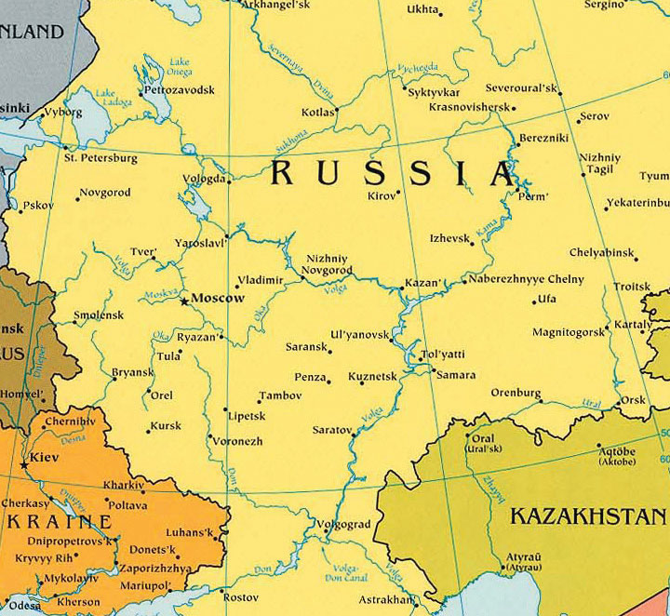
City of Moscow
White sea
Moscow – port of 5 seas: Baltic, Black, Caspian, white, Lake Ladoga
Moscow largest city of Russia
Lake Ladoga
N. Dvina river
Baltic sea
River Volga
Volga- Baltic water way
Moscow
River Volga
River Don
Black sea
Caspian sea

Slide 35
St. Petersburg region
St. Petersburg – financial hub
2nd largest city in Russia
oil and gas trade, electronics and IT manufacturing, heavy machinery and textile
St. Petersburg

Slide 36
Volga region
Perm, Kazan, Samara, Izhevsk, Volgograd
Volgograd – oil refinery and steel production
Samara- oil refining center
Rostov- agro-machinery
Urals
Perm
Kazan
Izhevsk
Samara
Volgograd

Slide 37
Volga region
Kazan- mechanical, petrochemical
Perm- electronics
Izhevsk- defence industries
Urals
Perm
Kazan
Izhevsk
Samara
Volgograd

Slide 38
Urals
Yekaterinburg, Magnitogorsk, Chelyabinsk, Nizhniy Tagil, Ufa
Yekaterinburg – machinery production
Magnitogorsk – steel industries
Iron from Orsk, Serov
Nizhniy Tagil
Yekaterinburg
Chelyabinsk
Magnitogorsk
Ufa

Slide 39
Urals
Chelyabinsk- heavy industries, military machinery
Ufa- oil refinery, petro-chemical
Nizhniy Tagil- metallurgical industries
Nizhniy Tagil
Yekaterinburg
Chelyabinsk
Magnitogorsk
Ufa

Slide 40
Kuzbas region
Omsk, Tomsk, Novosibirsk, Novo Kuznetsk
Omsk – aerospace manu., agro-processing
Tomsk- defence manufacturing
Innovation capital of Russia (biotech, IT, medicine, nuclear research)
Tomsk
Omsk
Novo Kuznetsk
Novosibirsk

Slide 41
Kuzbas region
Novosibirsk 3th largest city after Moscow and St. Petersburg
Novosibirsk – aircraft manufacturing, HEP engineering, textile, nuclear fuel
Novo Kuznetsk- iron and steel industry
Tomsk
Omsk
Novo Kuznetsk
Novosibirsk

Slide 42
Baykal Region
Krasnoyarsk, Bratsk, Irkutsk and Chita
Paper and pulp industries, timber, aluminium smelting
Krasnoyarsk- largest producer of aluminum
Irkutsk: HEP plant, metallurgical industries
Krasnoyarsk
Bratsk
Irkutsk
Chita

Slide 43
Baykal Region
Bratsk- heavy industry, aluminum plants
Chita-
Krasnoyarsk
Bratsk
Irkutsk
Chita

Slide 44
Trans-Siberian Railway
Longest in the world (8960 km)
St. Petersburg to Vladivostok
Via – Moscow, Kazan, Omsk, Novosibirsk, Krasnoyarsk, Irkutsk, Ulan Ude, Chita
Branches to Mongolia, China and North Korea

Slide 45
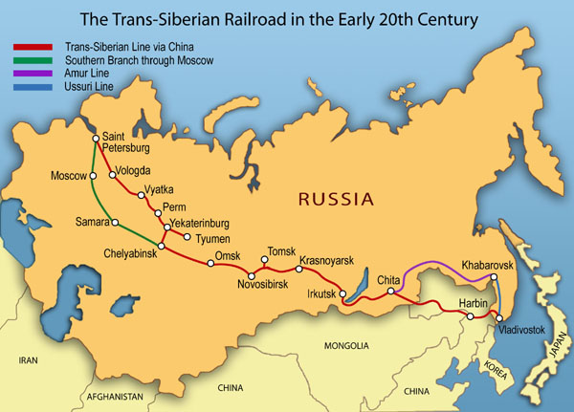
Route of Trans-Siberian railway

